Slide 1
Multimedia Content in E-commerce

Slide 2

01
Definition of multimedia content
02
Importance in e-commerce
Overview: Multimedia Content
03
Types: Video, Audio, Images
04
Impact on user engagement
05
Future trends

Slide 3

Desktop Video Processing
Definition and Role
Desktop video processing involves editing and enhancing videos for promotional and informational purposes. It is crucial for creating compelling visual content in e-commerce.
Applications
Used in product demos, advertisements, and tutorials to enhance customer understanding and engagement.
Trends
Advanced tools and AI-powered video editing are transforming how businesses present their products.

Slide 4

Tools for Desktop Video Processing
Popular Software
Top tools include Adobe Premiere Pro, Final Cut Pro, and DaVinci Resolve, offering powerful editing features for e-commerce needs.
Affordable Options
Apps like iMovie, Canva Video, and Clipchamp are accessible for smaller businesses to create professional content.
Key Features
Key capabilities include video trimming, color grading, effects, and motion graphics for impactful presentations.

Slide 5

Applications in E-commerce
Product Demonstrations
High-quality videos showcase product features effectively, enabling customers to make informed decisions.
Tutorials and Guides
Videos help customers understand product usage, boosting satisfaction and reducing returns.
Advertisements
Professionally edited videos create engaging advertisements that attract a broader audience.

Slide 6

Emerging Trends in Video Processing
AI-Powered Editing
AI tools like Runway and Descript make video editing faster and more intuitive for businesses.
360-Degree Videos
Interactive videos allow customers to explore products in a virtual 3D environment.
AR/VR Integration
Augmented and virtual reality are revolutionizing e-commerce by creating immersive shopping experiences.

Slide 7

Challenges in Video Processing
Cost and Time
High-quality video production requires significant investment in tools, resources, and time.
Skill Requirements
Effective video processing demands expertise in editing tools, which can be a barrier for some businesses.
Scalability
Creating videos for a large catalog of products may be resource-intensive and difficult to manage.

Slide 8

Desktop Video Conferencing
Definition and Role
Desktop video conferencing refers to using software to facilitate virtual meetings and interactions, crucial for customer support and consultations in e-commerce.
Applications
Enables real-time customer interactions, team meetings, and expert consultations, making e-commerce experiences more interactive.
Trends
The rise of tools like Zoom and Microsoft Teams has streamlined virtual connections for businesses and consumers alike.

Slide 9

Tools for Desktop Video Conferencing
Popular Platforms
Common tools include Zoom, Microsoft Teams, and Google Meet, widely used for e-commerce and communication needs.
Advanced Features
Platforms offer screen sharing, virtual backgrounds, and live transcription for enhanced usability.
Custom Solutions
Some businesses develop custom conferencing tools tailored to specific e-commerce requirements.

Slide 10

Applications in E-commerce
Customer Support
Video conferencing enables real-time interactions to resolve customer queries effectively.
Team Collaboration
Facilitates seamless communication among e-commerce teams working remotely.
Live Sales Events
Businesses host live product demonstrations and Q&A sessions to boost customer engagement.

Slide 11

Emerging Trends in Video Conferencing
Hybrid Events
Combining virtual and physical experiences to create dynamic e-commerce events.
AI Features
Real-time translations and voice recognition tools enhance accessibility and global reach.
Integration with Tools
Seamless integration with CRM and e-commerce platforms streamlines operations.

Slide 12

Challenges in Video Conferencing
Connectivity Issues
Stable internet connections are crucial for effective video conferencing, which can be a challenge in some regions.
Privacy and Security
Protecting sensitive information during video calls requires robust security protocols.
Technical Expertise
Users need a certain level of tech-savviness to use advanced conferencing tools effectively.

Slide 13
Comparison of Video Processing & Conferencing
Similarities
Differences
Impact
Both improve user engagement in e-commerce and require multimedia tools for effective implementation.
Video processing focuses on content creation while conferencing emphasizes real-time communication.
Together, they enhance customer interaction and create immersive e-commerce experiences.

Slide 14

Customer Experience
Multimedia enhances the shopping experience, making it more interactive and engaging for customers.
The Role of Multimedia in E-commerce
From video processing to conferencing, multimedia tools bridge the gap between virtual and physical shopping experiences.

Slide 15
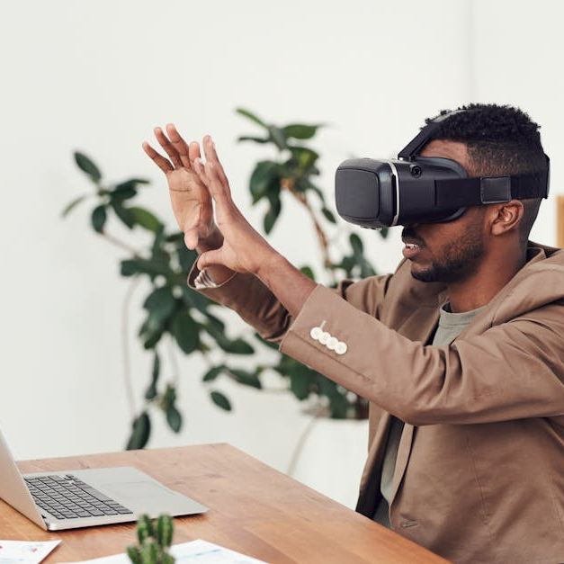
Future of Multimedia in E-commerce
Increased Personalization
AI and multimedia tools will enable hyper-personalized shopping experiences.
Immersive Technologies
AR and VR will dominate e-commerce, allowing customers to visualize products in real-time.
Enhanced Engagement
Live video, interactive content, and conferencing will redefine customer interaction.

Slide 16
Thank You

